Slide 1
Spectre & Meltdown

Slide 2
Preliminary (Task 1&2)
Flush+Reload Attack
Check if a cache line is in cache
A commonly seen side channel
Flush:
Using _mm_clflush to force CPU to evict cache to lower level(maybe memory).
Flushing the array
Reload:
Measure the time spent for each memory access
The fastest one should be just accessed by the victim.

Slide 3
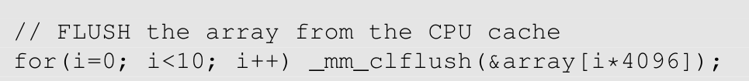
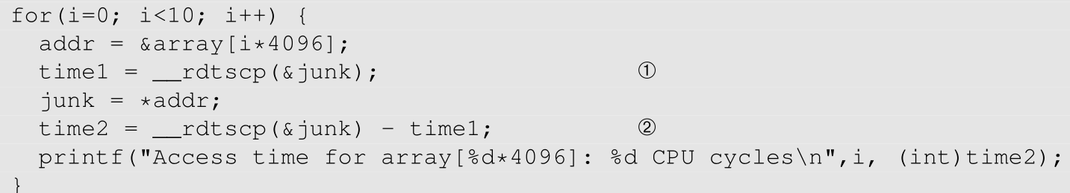
Preliminary (Task 1&2)
Flushing the array.
Access some elements of the array
Reload the array and measure the time

Slide 4
Kernel Module (Task 3)
Kernel module is part of kernel
It’s not a thread. It creates a file under the proc directory.
It registers file open handler. The handler will be called on reading the file.
The module puts a string in secret_buffer, and print the address.
This is done in the init phase.
You may check the address via dmesg
printk is the printf() in kernel
It stores string in a piece of buffer
dmesg fetches the buffer

Slide 5
Access the secret (Task 4)
You know the address of the secret.
It is shown in dmesg.
However, you cannot dereference it.
For kernel addresses, the privilege bit of the PTE is set
Page fault will be triggered.
Your process will be killed by default.

Slide 6
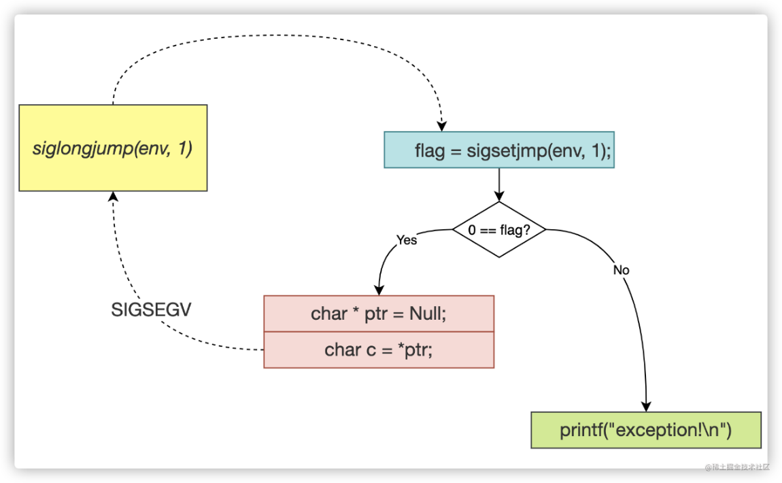
Exception Handling in C (Task 5)
Try to implement C style exception handling
We already covered in lecture
By setjump and long jump

Slide 7
Meltdown (Task7)
Getting secret cached
Read it by reading the proc file.
Although the string is not returned to userspace, it is in cache.
It is cached in the core reading the file, which may be different from the core running victim program. You may use taskset to make them the same.
Block ALU
Try add some junk calculations before the kernel address accessing.
So the ALU resources are amortized, and the fault will be triggered later.

Slide 8
Task 8: Make it more accurate
Run meltdown multiple times for an address.
If our attack program thinks k is the secret, scores[k] is increased by 1.
Make final decision according to the scores

Slide 9
Bonus - Meltdown w/o clflush
_mm_clflush invokes CLFLUSH instruction
Userspace CLFLUSH CAN be disabled
Kernel can disable it by setting special registers.
So, you may not be able to flush cache in some cases.
Try to flush cache by cache eviction
Filling cache set by junk lines, so cache is cleared.
Assuming LRU algorithm used by the CPU.

Slide 10
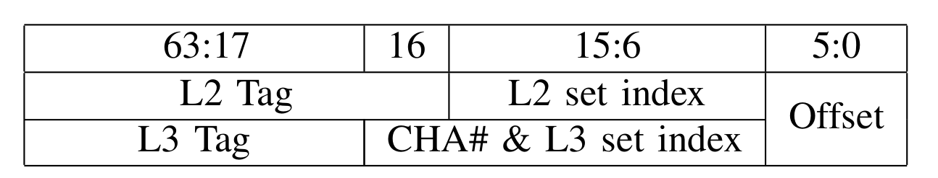
Bonus – Attack w/o clflush
Try to use cache eviction to accurately flush size and array.
Try to find an eviction set
Accessing all the addresses in the set causes flushing the whole set
Each core of our server has 1MB L2, which has 16 ways and 1024 sets.
Addresses with the same set index will be mapped into the same set.
So the eviction set has at least 16 addresses, mapping into the same set with the address to be flushed.
Try to know the set of an address
Normally, you cannot get the physical addresses.
But if you use 2M huge page, the lower 20 bits will be the same for physical and virtual addresses.
Try to make array and size in huge page.

Slide 11
Spectre – Branch Prediction (Task 3 & 4)
Firstly Train the branch predictor to True
Legally invoke victim() 10 times
Use victim() to access an illegal line
Flush size
So the check runs slowly
Reload to measure time

Slide 12
Task 5 Improving the accuracy
Run the attack multiple times

